Slide 1

Yelp Data Analysis
Recommendations for Chinese Restaurants

Slide 2
Introduction to Data
Contents
Exploratory Data Analysis
Recommendations from Attributes
Recommendations from Reviews

Slide 3
Introduction to Data
Overlook of the Dataset
User reviews of each restaurant
Detailed information about the business.
User information
Tips from users of each business.
Data Selection
We select all the businesses with word Chinese in its description

Slide 4
EDA
Basic distribution of review ratings
Min. | 1st Qu. | Median | Mean | 3rd Qu. | Max
1.00 | 2.00 | 4.00 | 3.53 | 5.00 | 5.00

Slide 5
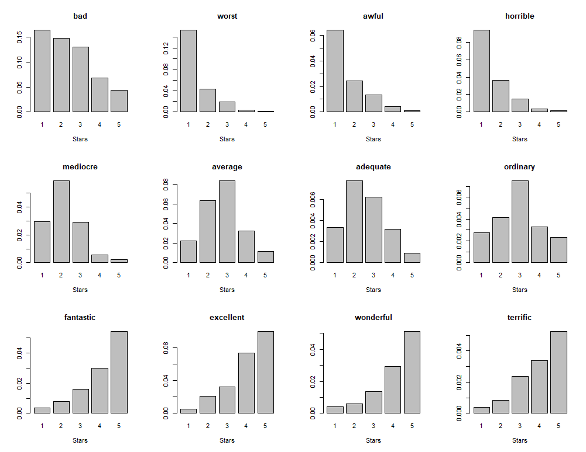
EDA
Basic word
frequency counts

Slide 6
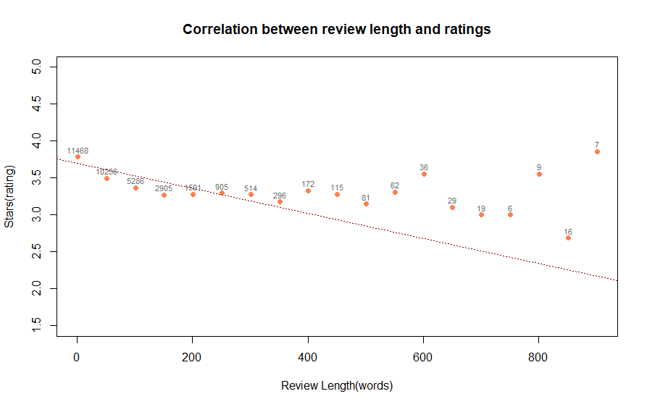
EDA
A negative correlation
between review length
and ratings
[ 50*(i-1)+1, 50*i ]

Slide 7
Key Findings
1. We find that providing restaurants reservation and good kids environment, not providing food delivery and credit card acceptation increases ratings.
 | reservation | good kids | not food delivery | not accept credit card
p-value | 1.482e-05 | 0.02555 | 0.02302 | 0.0143
mean difference | 0.24 | 0.24 | 0.12 | 0.32
2. We find that there is no difference in whether provide food take out, whether provide alcohol, whether have TV and whether provide Wi-Fi with respect to ratings
 | food take out | alcohol | TV | WiFi
p-value | 0.6636 | 0.6256 | 0.2021 | 0.1037
mean difference | -0.04 | -0.017 | 0.10 | 0.12

Slide 8
test
We use Wilcoxon-Rank test to see whether some attributes of business are related to ratings. The null hypothesis is that the attribute is not related to the ratings. We choose significant level 0.05. If the p-value is less than 0.05, we think the attribute is related to the ratings. We can also get the 95% confidence interval of average ratings difference between group:
 | reservation | good kids | not food delivery | not accept credit card | food take out | alcohol | TV | WiFi
lower | 2.77e-05 | 1.46e-05 | 6.32e-05 | 4.19e-05 | -0.50006 | -4.1e-05 | -4.5e-05 | -4.8e-05
upper | 5.00e-01 | 5.00e-01 | 6.63e-05 | 5.00e-01 | 0.49996 | 1.84e-06 | 6.79e-05 | 6.55e-05

Slide 9
diagnostics
We checked the normality and variance homogeneity for each attribute group of data.
a. Firstly, we use Shapiro-Wilk test to check the normality of data. The p-value are all less than 0.05, so with significant level 0.05, we think the data are not normal. In this situation, we can not use t-test, so we use nonparametric test: Wilcoxon-Rank test to see whether there is relationship between some attributes and ratings.
p-value | reservation | good kids | not food delivery | not accept credit card | food take out | alcohol | TV | WiFi
Yes group | 5.23e-09 | 2.92e-14 | 6.24e-09 | 0.01444 | 2.82e-15 | 1.19e-06 | 2.37e-13 | 2.17e-05
No group | 4.10e-11 | 0.01293 | 3.48e-11 | 4.99e-15 | 0.02189 | 2.52e-11 | 1.09e-05 | 1.39e-12

Slide 10
diagnostics
Secondly, we use F-test to check the variance homogeneity of the two group of data. If the p-value is less than 0.05, we think with significant level 0.05, the variance is different between two group. According to whether the data have variance homogeneity, we will use different type of Wilcoxon-Rank test
 | reservation | good kids | not food delivery | not accept credit card | food take out | alcohol | TV | WiFi
p-value | 0.00165 | 0.03022 | 0.437 | 0.5552 | 0.5082 | 0.00055 | 0.01737 | 0.2726

Slide 11
Recommendations
a. Providing restaurants reservation to increase ratings: on average, a Chinese restaurants with reservation had 0.24 star higher rating compared to a Chinese restaurants without reservation (Wilcoxon-Rank test p-value:1.482e-05).
b. Providing special food and toy for children: on average, a Chinese restaurants which is good for children had 0.24 star higher rating compared to a Chinese restaurants which is not good for children (Wilcoxon-Rank test p-value:0.02555).
c. Not accepting credit card payment: on average, a Chinese restaurants which do not accept credit card had 0.32 star higher rating compared to a Chinese restaurants which accept credit card (Wilcoxon-Rank test p-value:0.0143).
d. It's not worth providing food delivery: Although food delivery is related to the ratings, the average ratings for food delivery Chinese restaurant is only 0.12 higher than no food delivery chinese restaurant.
e. It's not worth investing in food take out, alcohol, WiFi and TV: these four attributes are not related to the ratings (Wilcoxon-Rank test p-value are all greater than 0.05).

Slide 12
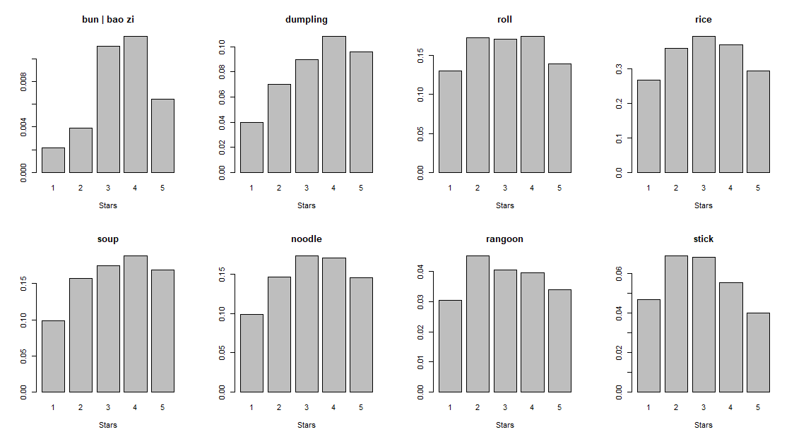
More about reviews
Correlation between
different main foods
and review ratings

Slide 13
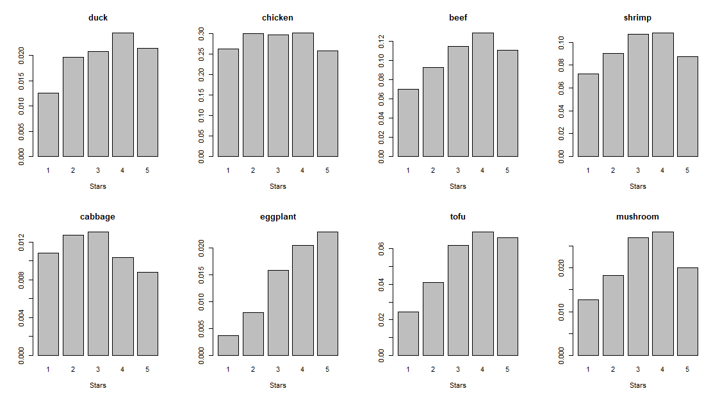
More about reviews
Correlation between
different dishes
and review ratings

Slide 14
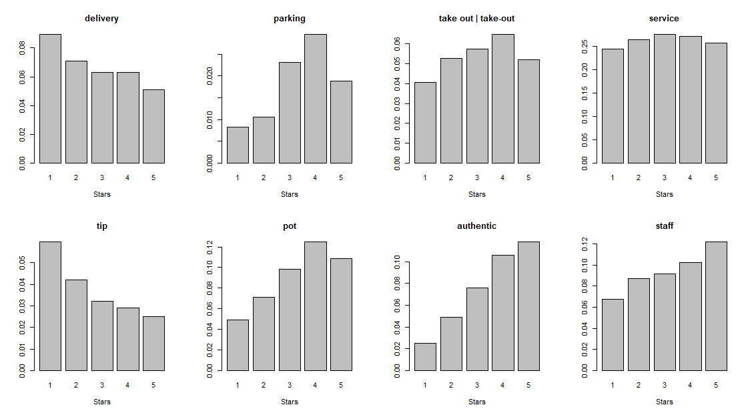
More about reviews
Correlation between
some other interesting
Words and review ratings

Slide 15
Summary
Data
Chinese restaurants are selected.
Recommendations
Provide reservation service,
Being good for kids,
Provide food delivery
Accept cash instead of credit card
For meals, bun, dumplings, and soup will be most likely to boost the business
For other dishes, duck, beef, eggplant and tofu are the best choices.

Slide 16
Thank You

